Slide 1

TAIBAH UNIVERSITY
Faculty of Science
Department of Math.
جامعة طيبة
كلية علوم وهندسة الحاسبات بينبع
Probability and Statistics for Engineers
STAT 301
Second Semester 1435/1436
Teacher : Dr.Osama Hosam

Slide 2
Chapter 2: Lesson 1
Events

Slide 3
Contents
Statistical Experiment
Sample Space
Events

Slide 4
Statistical Experiment :
An Experiment
Is some procedure (or process) that we do and it results in an outcome.
A random experiment
Is an experiment we do not know its exact outcome in advance but we know the set of all possible outcomes.
It is also called statistical experiment

Slide 5
The Sample Space:
Definition :
The set of all possible outcomes of a statistical experiment is called the sample space and is represented by the symbol S.
Each outcome (element or member) of the sample space S is called a sample point.

Slide 6
The Sample Space (Example 1):
The sample space of possible outcomes when a coin is tossed, may be written :
S= {H,T}
where
H and T correspond to "heads" and "tails," respectively.

Slide 7
The Sample Space (Example 2):
Consider the experiment of tossing a die .
If we are interested in the number that shows on the top face, the sample space would be :
S₁= {1,2,3,4,5,6 }
If we are interested only in whether the number is even or odd, the sample space
is
S₂= {even,odd}

Slide 8
The Sample Space (Example 2):
Example 2. illustrates the fact that :
More than one sample space can be used to describe the outcomes of an experiment.
In this case S₁ provides more information than S₂
It is desirable to use a sample space that
gives the most information concerning the outcomes of the experiment

Slide 9
The Sample Space (Example 3):
An experiment consists of flipping a coin and then flipping it a second time if a head occurs. If a tail occurs on the first, flip, then a die is tossed once.
To list the elements of the sample space, we construct the tree diagram
S= {HH. HT. T1, T2, T3, T4, T5, T6}.

Slide 10
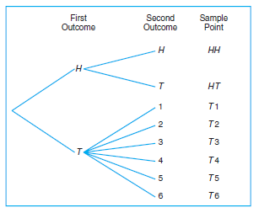
The Sample Space (Example 3):

Slide 11
The Sample Space (Example 4):
Sample spaces with a large or infinite number of sample points are best described by a statement or Rule Method.
If the possible outcomes of an experiment are the set of cities in the world with a. population over 1 million, our sample space is written
S = {x | x is a city with a population over 1 million},
which reads "S is the set of all x such that x is a city with a population over 1 million."

Slide 12
Events :
Definition
An event A is a subset of the sample space S. That is A⊆S.
We say that an event A occurs if the outcome (the result) of the experiment is an element of A.

Slide 13
Events :
φ⊆S is an event
(φ is called the impossible event)
S⊆S is an event
(S is called the sure event)

Slide 14
Events (Example 1) :
Given the sample space S = { t | t > 0 }, where t is the life in years of a certain electronic component .
The event A that the component fails before the end of the fifth year is the subset A = { t | 0 < t < 5 }.

Slide 15
Events (Example 2) :
Experiment: Selecting a ball from a box containing 6 balls numbered 1,2,3,4,5 and 6. (or tossing a die)
This experiment has 6 possible outcomes
The sample space is
S={1,2,3,4,5,6}.

Slide 16
Events (Example 2) :
Consider the following events:
E₁= getting an even number ={2,4,6}⊆S
E₂ = getting a number less than 4={1,2,3}⊆S
E₃ = getting 1 or 3={1,3}⊆S
E₄ = getting an odd number={1,3,5}⊆S
E₅ = getting a negative number={ }=φ ⊆S
E₆ = getting a number less than 10 ={1,2,3,4,5,6} = S⊆S

Slide 17
Events :
Notation:
n(S)= no. of outcomes (elements) in S.
n(E)= no. of outcomes (elements) in the event E.

Slide 18
Events (Example 3) :
Experiment:
Selecting 3 items from manufacturing process; each item is inspected and classified as defective (D) or non-defective (N).
This experiment has 8 possible outcomes
S={DDD,DDN,DND,DNN,NDD,NDN,NND,NNN}

Slide 19
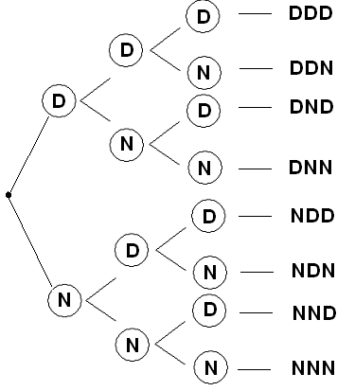
Events (Example 3) :

Slide 20
Events (Example 3) :
Consider the following events:
A={at least 2 defectives}=
{DDD,DDN,DND,NDD}⊆S
B={at most one defective}=
{DNN,NDN,NND,NNN}⊆S
C={3 defectives}=
{DDD}⊆S

Slide 21
Operations on Events

Slide 22
Contents
Complement
Intersection
Mutually Exclusive
Union

Slide 23
Operation on Events (Complement) :
Definition
The complement of an event A with respect to S is the subset of all elements of S that are not in A.
We denote the complement, of A by the symbol A` or A^{C} .
A^{c} = {x ∈S: x∉A }
A^{c} occurs if A does not.

Slide 24
Operation on Events (Complement) :
Venn Diagram
S

Slide 25
Operation on Events (Example 1) :
Let R be the event that a red card is selected from an ordinary deck of 52 playing cards, and let S be the entire: deck. Then R^{C} is the event that the card selected from the deck is not a red but a black card.

Slide 26
Operation on Events (Example 2) :
Consider the sample space
S = {book, catalyst, cigarette, precipitate, engineer, rivet}.
Let A = {catalyst, rivet, book, cigarette}
Then A' = {precipitate, engineer}.

Slide 27
Operation on Events (Intersection) :
Definition
Let A and B be two events defined on the sample space S.
The intersection of two events A and B denoted by the symbol A ∩ B,
Is the event containing all elements that are common to A and B.

Slide 28
Operation on Events (Intersection) :
A∩B = AB = {x ∈S: x∈A and x∈B}
A∩B Consists of all points in both A and B.
A∩B Occurs if both A and B occur together.

Slide 29
Operation on Events (Intersection) :
Venn Diagram
S

Slide 30
Operation on Events (Example 1) :
Let C be the event that a person selected at random in an Internet cafe is a college student, and let M be the event that the person is a male. Then C∩ M is the event of all male college students in the Internet cafe.

Slide 31
Operation on Events (Example 2) :
Let
M = {a ,e,I,o,u} and N = {r, s,t}
M ∩ N = φ.
M and N have no elements in common and, therefore, cannot both occur simultaneously.

Slide 32
Mutually Exclusive :
Definition
Two events A and B are mutually exclusive (or disjoint) if and only if A∩B = φ; that is, A and B have no common elements (they do not occur together).

Slide 33
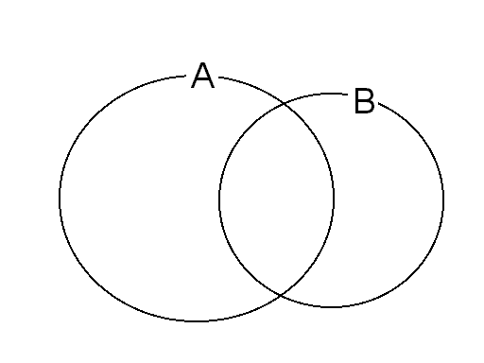
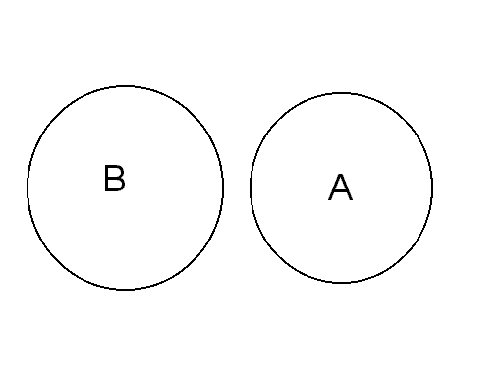
Mutually Exclusive :
Venn Diagram
A∩B ≠ φ
A and B are not mutually exclusive
A∩B = φ
A and B are mutually exclusive (disjoint)

Slide 34
Operation on Events (Union) :
Definition
The union of the two events A and B, denoted by the symbol A ∪ B, is the event containing all the elements that belong to A or B or both.

Slide 35
Operation on Events (Union) :
A∪B = {x ∈S: x∈A or x∈B }
A∪B Consists of all outcomes in A or in B or in both A and B.
A∪B Occurs if A occurs, or B occurs, or both A and B occur.
That is A∪B Occurs if at least one of A and B occurs.

Slide 36
Operation on Events (Union) :
Venn Diagram
S

Slide 37
Union (Examples) :
Let A = {a,b,c} and B = {b,c,d,e}
Then A ∪ B = {a,b,c,d,e}.
If M = {x | 3 < x < 9} and V = {y \ 5 < y < 12}, Then
M ∪ N = [z | 3 < z < 12}.

Slide 38
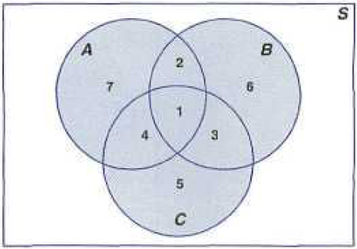
Union (Examples) :
Venn Diagram

Slide 39
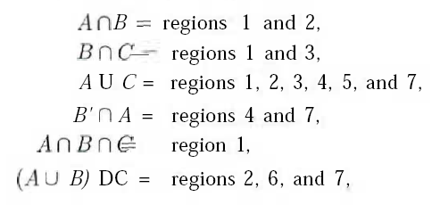
Union (Examples) :

Slide 40
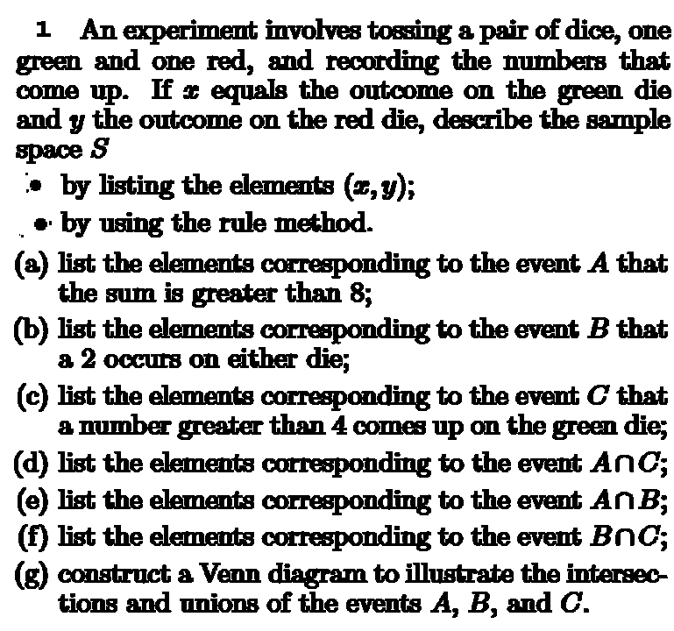
Exercises

Slide 41
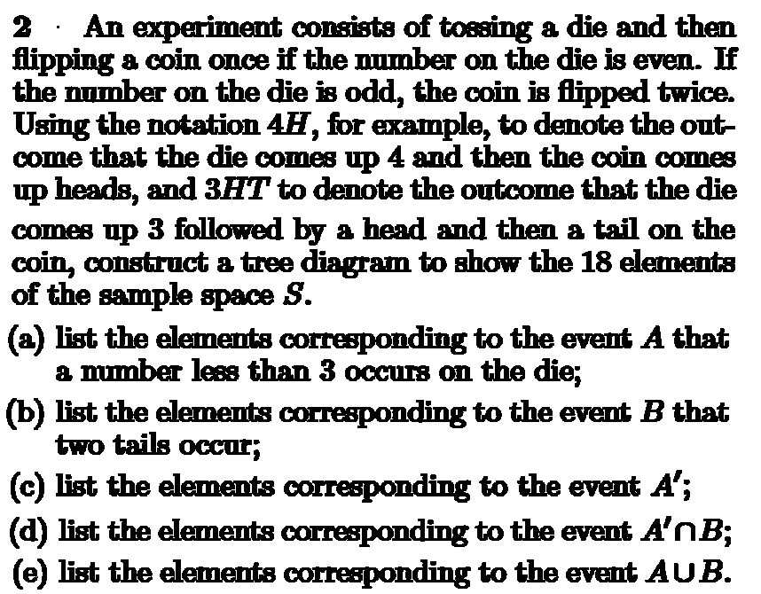
Exercises

Slide 42
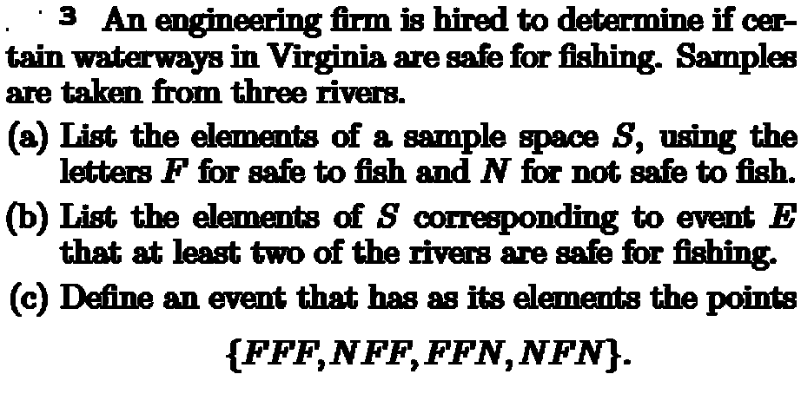
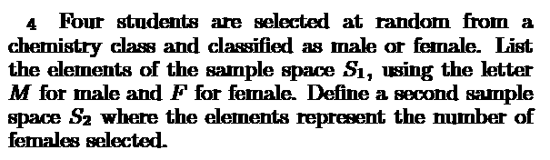
Exercises

Slide 43
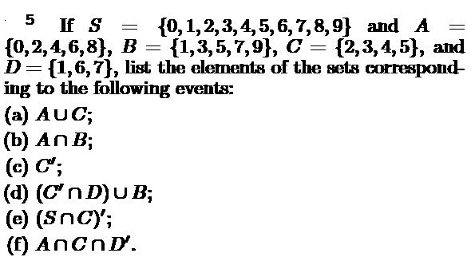
Exercises

Slide 44
Counting Techniques

Slide 45
Contents
Multiplication Rule
Permutations

Slide 46
Counting Sample Points:
There are many counting techniques which can be used to count the number points in the sample space (or in some events) without listing each element.
In many cases, we can compute the probability of an event by using the counting techniques.

Slide 47
Multiplication Rule:
Theorem
If an operation can be performed in n₁ ways , and if for each of these ways a second operation can be performed in n₂ ways , then the two operations can be performed together in n₁ n₂ ways.

Slide 48

Multiplication Rule (Example 1):
How many sample points are: there: in the sample space when a pair of dice is
thrown once?

Slide 49
Multiplication Rule (Example 1):
The first die can land in any one of n₁ =6 ways. For each of these 6 ways the second die can also land in n₂ =6 ways. Therefore, the pair of dice can land in:
n₁ n₂ = (6)(6) = 36 possible ways.

Slide 50
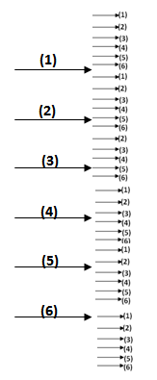
Multiplication Rule (Example 1):

Slide 51
Multiplication Rule:
Theorem
If an operation can be performed in n₁ ways, and if for each of these a second operation can be performed in n₂ ways, and for each of the first two a third operation can be performed in n₃ ways, and so forth, then the sequence of k operations can be performed in
n₁ n_{2 ……..} n_{k} ways.

Slide 52
Multiplication Rule (Example 2):
Sam is going to assemble a computer by himself. He has the choice of ordering chips from two brands, a hard drive from four, memory from three, and an accessory bundle from five local stores. How many different, ways can Sam order the parts?

Slide 53
Multiplication Rule (Example 2):
Solution:
Since n₁ = 2 , n₂ = 4 , n₃ = 3 and n₄ = 5
There are :
n₁ × n₂ × n₃ × n₄
= 2 × 4 × 3 × 5 = 120
different ways to order the parts.

Slide 54

Multiplication Rule (Example 3):
How many even four-digit numbers can be formed from the digits 0, 1, 2, 5, 6, and 9 if each digit can be used only once?

Slide 55
Multiplication Rule (Example 3):
Solution:
Since the number must be even, we have only n₁ = 3 (0,2,6) choices for the units position
However, for a four-digit number the thousands position cannot be 0 .
Hence we consider the units position by two parts, 0 or not 0.

Slide 56
Multiplication Rule (Example 3):
if units position is 0 ( i.e. n₁ = 1 ) we have
n₂ = 5 : thousands position.
n₃ = 4 : hundreds position.
n₄ = 3 : tens position.
Therefore, in this case we have a total of
n₁ × n₂ × n₃ × n₄
= 1 × 5 × 4 × 3 = 60
even four-digit numbers

Slide 57

Multiplication Rule (Example 3):

Slide 58
Multiplication Rule (Example 3):
if units position is not 0 ( i.e. n₁ = 2 ) we have
n₂ = 4 : thousands position.
n₃ = 4 : hundreds position.
n₄ = 3 : tens position.
Therefore, in this case we have a total of
n₁ × n₂ × n₃ × n₄
= 2 × 4 × 4 × 3 = 96
even four-digit numbers

Slide 59
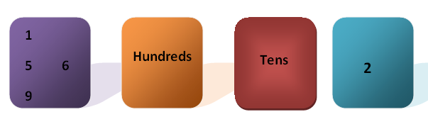
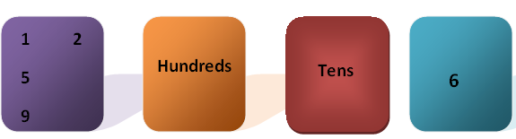
Multiplication Rule (Example 3):

Slide 60
Multiplication Rule (Example 3):
Since the two cases are mutually exclusive of each other, the total number of even four-digit numbers can be calculated by:
60+96 = 156
even four-digit numbers

Slide 61
Permutations:
Definition
A permutation is an arrangement of all or part of a set of objects.
Consider the three letters a, b, and c. The possible permutations are:
abc, acb,bac, bca, cab, and cba.
There are 6 distinct arrangements

Slide 62
Permutations:
We can reach the same answer if we use multiplication rule:
n₁ × n₂ × n₃
= 3 × 2 × 1= 6 permutation

Slide 63
Permutations (Factorial):
In general, n distinct objects can be arranged in
n(n - l)(n - 2) • • • (3)(2)(1) ways.
This product is called factorial and represents by n!
The number of permutations of n objects is n!.

Slide 64
Permutations:
Theorem
The number of permutation of n distinct objects taken r at a time is

Slide 65
Permutations:

Slide 66
Permutation (Example 1):
In one year, three awards (research, teaching, and service) will be given for a class of 25 graduate students in a statistics department. If each student can receive at most one award, how many possible selections are there?

Slide 67
Permutation (Example 1):
Since the awards are distinguishable, it is a permutation problem. The total number of sample points is

Slide 68
Permutations (Example 2):
A president and a treasurer are to be chosen from a student club consisting of 50 people. How many different choices of officers are possible if
(a) There are no restrictions;
(b) A will serve only if he is president;
(c) B and C will serve together or not at all:
(d) D and E will not serve together?

Slide 69
Permutations (Example 2):
(a) The total number of choices of the officers if there are no restrictions is:

Slide 70
Permutations (Example 2):
(b) Since A will serve only if he is the president , we have two situations here:
(i) A is selected as the president, which yields 49 possible outcomes;
Treasurer
B
C
.
AX
President
A
AB | AC | AD | … | AAX

Slide 71
Permutations (Example 2):
(ii) Officers are selected from the remaining 49 people which has the number of choices
Therefore, the total number of choices is:

Slide 72
Permutations (Example 2):
(C) The number of selections when B and C serve together is 2
BC | CB
The number of selections when both B and C are not chosen is :
Therefore, the total number of choices is:

Slide 73
Permutations (Example 2):
(i) The number of selections when D serves as an officer but not E is (2) (48) = 96
Treasurer
48
E not Exist
President
48
E not Exist
President
D
+
Treasurer
D
(ii) The number of selections when E serves as an officer but not D is also (2) (48) = 96

Slide 74
Permutations (Example 2):
(iii) The number of selections when both D and E are not chosen is
Therefore, the total number of choices is:
OR: Since D and E can only serve together in 2 ways, the answer is 2450 - 2 = 2448.

Slide 75
Permutations:
Theorem
The number of distinct permutations of n things of which n₁ are of one kind, n₂ of a second kind,..., n_{k} of a kth kind is:

Slide 76
Permutations (Example 3):
How many words consisting of 3 letters that can be construct from a x x ?
axx | xax | xxa | = | 3

Slide 77
Permutations (Example 4):
In a college football training session, the defensive coordinator needs to have 10 players standing in a row. Among these 10 players, there are 1 freshman, 2 sophomores, 4 juniors, and 3 seniors, respectively. How many different ways can they be arranged in a row if only their class level will be distinguished?

Slide 78
Permutations (Example 4):
the total number of arrangements is

Slide 79
Permutations :
Theorem
The number of ways of partitioning a set of n objects into r cells with n₁ elements
in the first cell, n₂ elements in the second, and so forth, is :

Slide 80
Permutations (Example 5):
In how many ways can 7 graduate students be assigned to one triple and two double hotel rooms during a conference ?

Slide 81
Combinations:
In many problems, we are interested in the number of ways of selecting r objects from n objects without regard to order. These selections are called combinations.

Slide 82
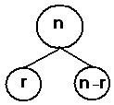
Combinations:
Theorem
The number of combinations of n distinct objects taken r at a time is denoted by
and is given by:

Slide 83
Combinations (Notes):
is read as “ n “ choose “ r ”.
Or n combination r

Slide 84
Combinations (Notes):

Slide 85


Combinations (Example1):
If we have 10 equal–priority operations and only 4 operating rooms are available, in how many ways can we choose the 4 patients to be operated on first?

Slide 86
Combinations (Example1):
n = 10 r = 4
The number of different ways for selecting 4 patients from 10 patients is

Slide 87
Combinations (Example1):
OR

Slide 88
Combinations (Example2):
How many different letter arrangements can be made from the letters in the word
of STATISTICS ?
Here we have total 10 letters, while 2 letters (S, T) appear 3 times each, letter appears twice, and letters A and C appear once each.

Slide 89
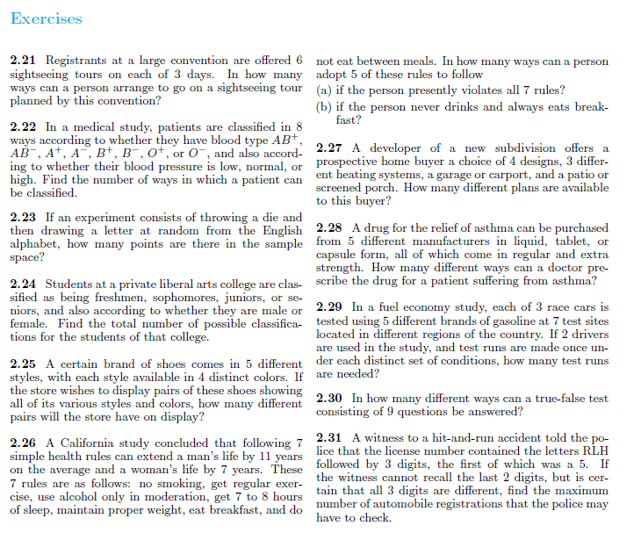

Slide 90
